Slide 1
ASSIGNMENT 04 Name: Amas Waseem Class: BSCS (Morning) Roll no: 35 Seat no: B20102077 Section: A

Slide 2
Introduction To Matlab

Slide 3
What Is MATLAB?
The name MATLAB stands for matrix laboratory.
MATLAB is a high-performance language for technical computing. It integrates computation, visualization, and programming in an easy-to-use environment where problems and solutions are expressed in familiar mathematical notation.

Slide 4
Uses of MATLAB
Math and computation
Algorithm development
Data analysis and visualization
Scientific and engineering graphics

Slide 5
The MATLAB Language.
This is a high-level matrix language with control flow statements, functions, data
structures, input/output, and object-oriented
programming features.

Slide 6
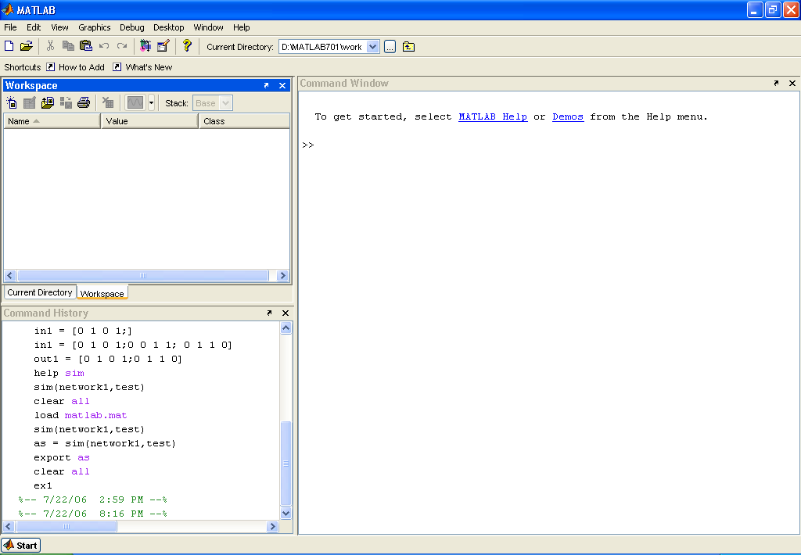
Development Environment
Run the Matlab

Slide 7
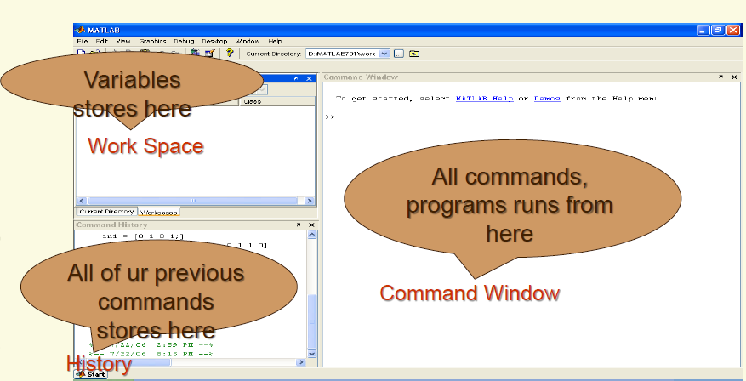
Development Environment a=4;

Slide 8
Vectors A=[2 3 4 5]
These come in two favors and we shall first describe row vectors: they are lists of numbers
separated by either commas or spaces. The number of entries is known as the \length" of the vector and the entries are often referred to as \elements" or \components" of the vector.
The entries must be enclosed in square brackets.

Slide 9
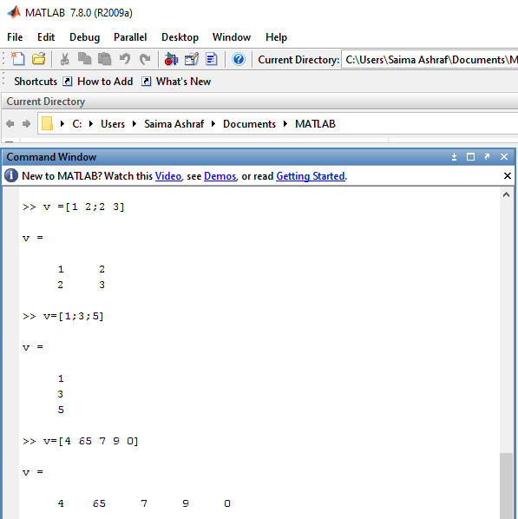
Vectors(I 10X10,10 ROW,10COL)

Slide 10
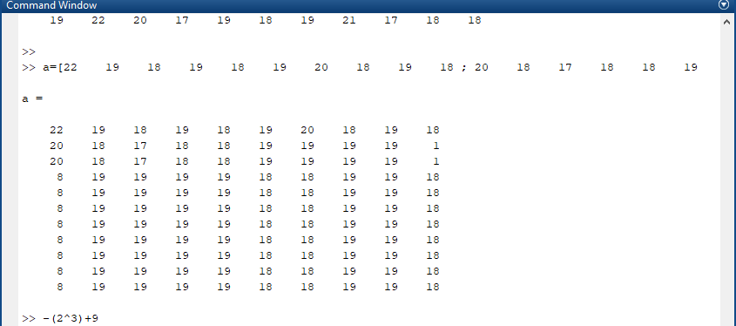
M. Amas Waseem

Slide 11
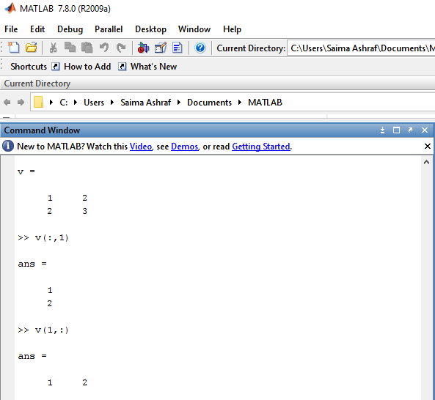
Vectors(10X10) :=null V(ROW,COL)

Slide 12
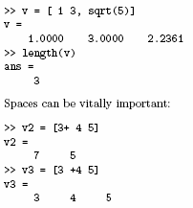
Vectors (I)
.

Slide 13
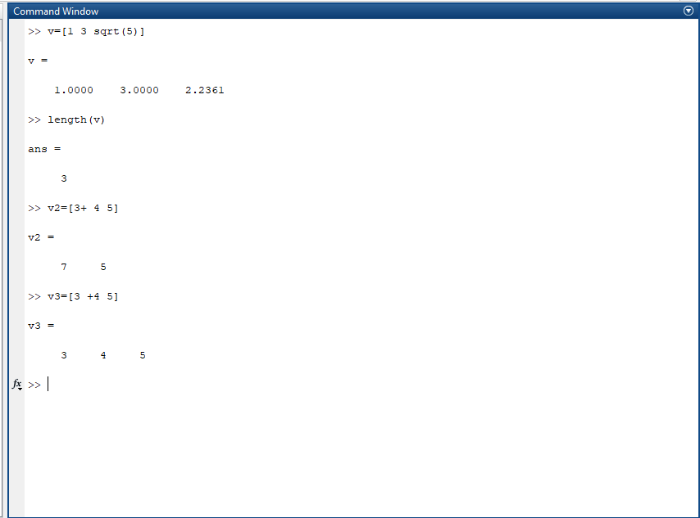
M. Amas Waseem

Slide 14
System And File Commands(I)
Clc: Clear the command window
Clear : Remove variable from memory
Doc: Display documentation
Quit or exit: Stops MATLAB
Who: List current variable
Whos: List current variables(long display)

Slide 15
Variables
MATLAB variable names must begin with a letter, which may be followed by any combination of letters, digits, and underscores. MATLAB distinguishes between uppercase and lowercase characters, so A and a are not the same variable(case sensitive).
When naming a variable, make sure you are not using a name that is already used as a function name,begin with character .

Slide 16
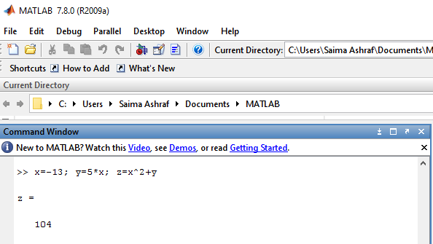
Equation Example(I)
Note also we can place several statements on one line, separated by commas or semicolons.

Slide 17
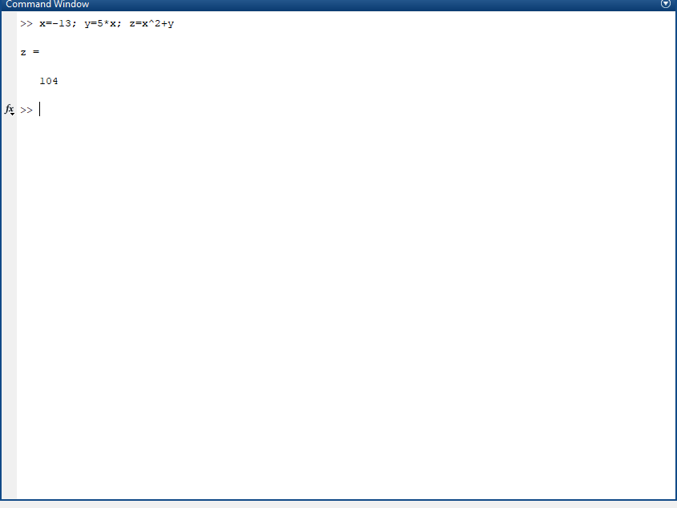
M. Amas Waseem

Slide 18
Example(I)
>> 2 + 3/4*5
ans =5.7500
>> 3-2^4
ans =-13
>> ans*5
ans = -65
Is this calculation 2 + 3/(4*5) or 2 + (3/4)*5? Matlab works according to the priorities.

Slide 19
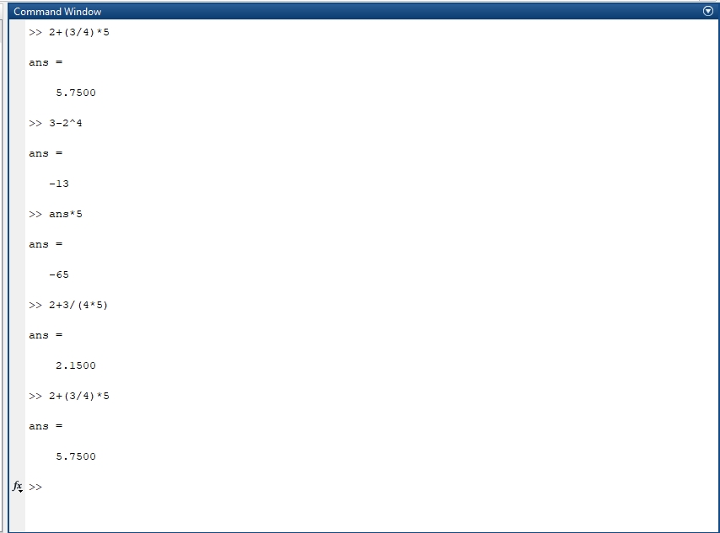
M. Amas Waseem

Slide 20

Exercise Question(I)
Exercise: In each case find the value of the expression in Matlab and explain precisely the order in which the calculation was performed.

Slide 21


M. Amas Waseem

Slide 22
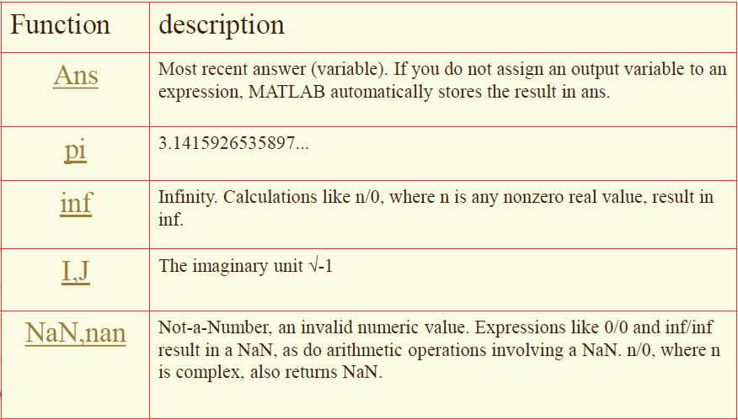
Special Values

Slide 23
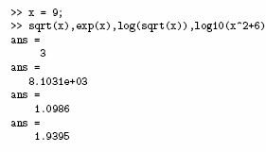
Built-In Functions(I)
Run on MATLAB

Slide 24
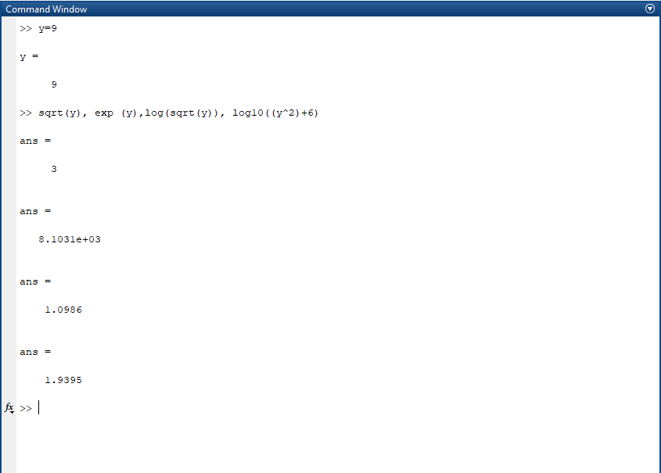
M. Amas Waseem

